Slide 1
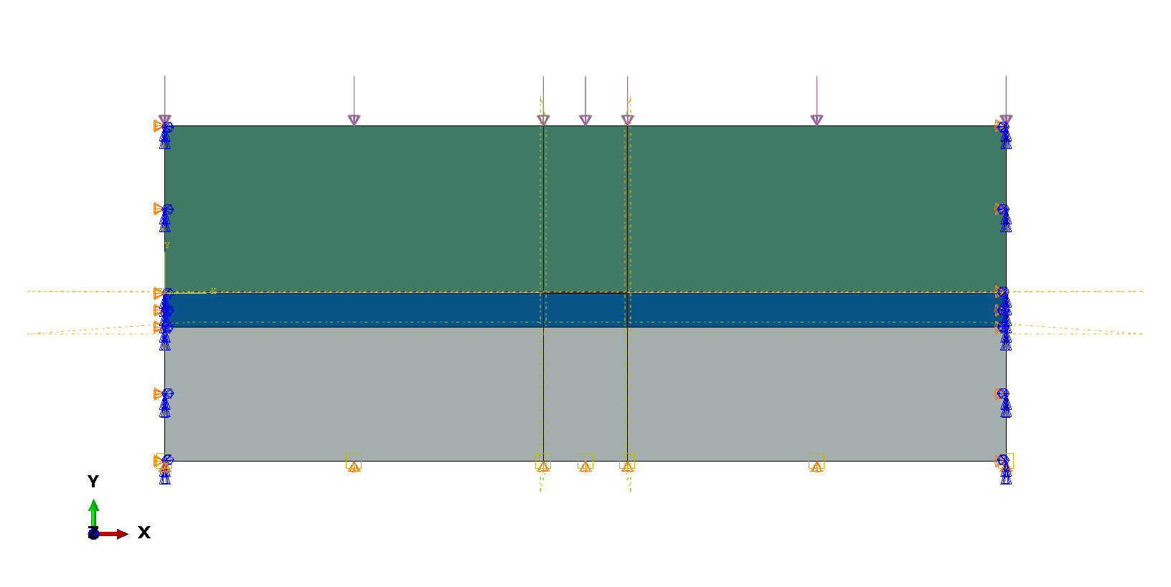

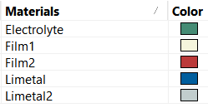
Electro-chemo-mechanical model
Boundary Conditions
Top surface
Current density
Pressure –
Bottom Surface
Fixed
Voltage = 0 V (Li Metal)
Left and right surfaces
Periodic boundary conditions
Interface conditions
Between Film and Li Metal
Tied
Free with frictional sliding
Electrolyte – LLZO – 10⁻⁴ S/cm
Film1 - 10⁻⁵ S/cm = Rct = 10 ohm-cm^2
Film2 - 10⁻⁷ S/cm = Rct = 100 ohm-cm^2

Slide 2
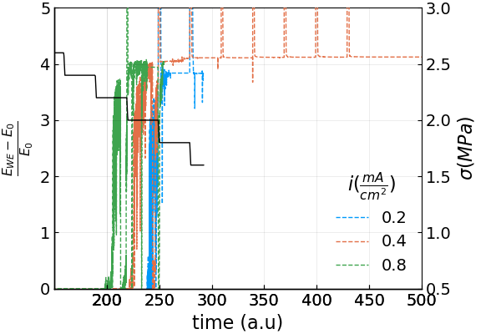
Results --- Low Rct center, high Rct sides
Stripping only
M.J. Wang, R. Choudhury, J. Sakamoto, Characterizing the Li-Solid-Electrolyte Interface Dynamics as a Function of Stack Pressure and Current Density, Joule. 3 (2019) 2165–2178. https://doi.org/10.1016/j.joule.2019.06.017.

Slide 3
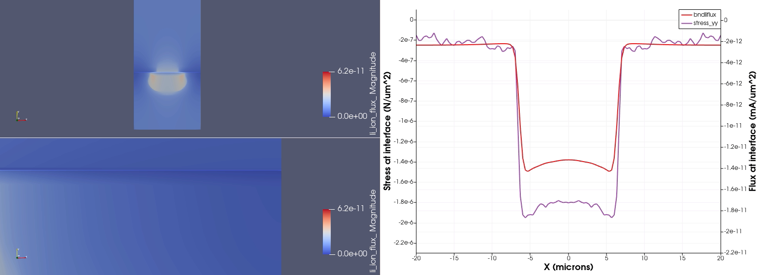
Plating at 1.2mA/cm^2
Plating 1.2 mA/cm^2
More removal from in the middle (low Rct)
Pressure and Flux slowly go to 0 showing separation
Due to decreased contact area (overpotential) increases.

Slide 4
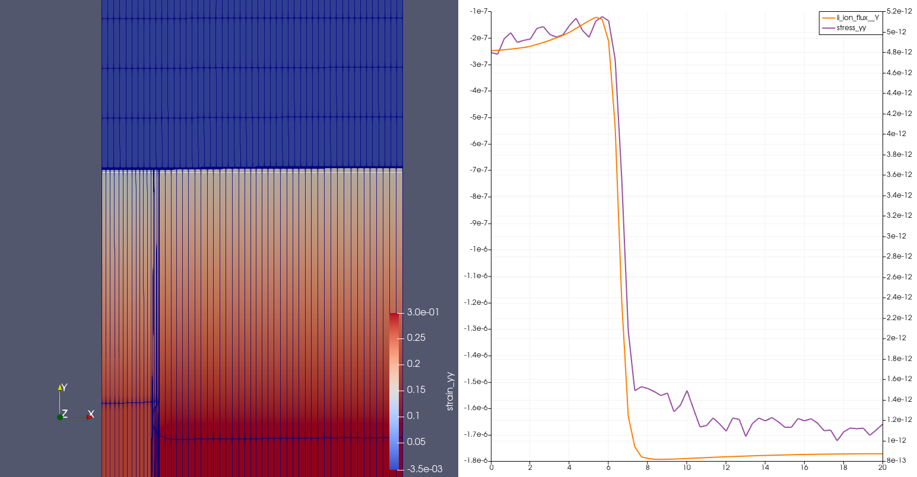
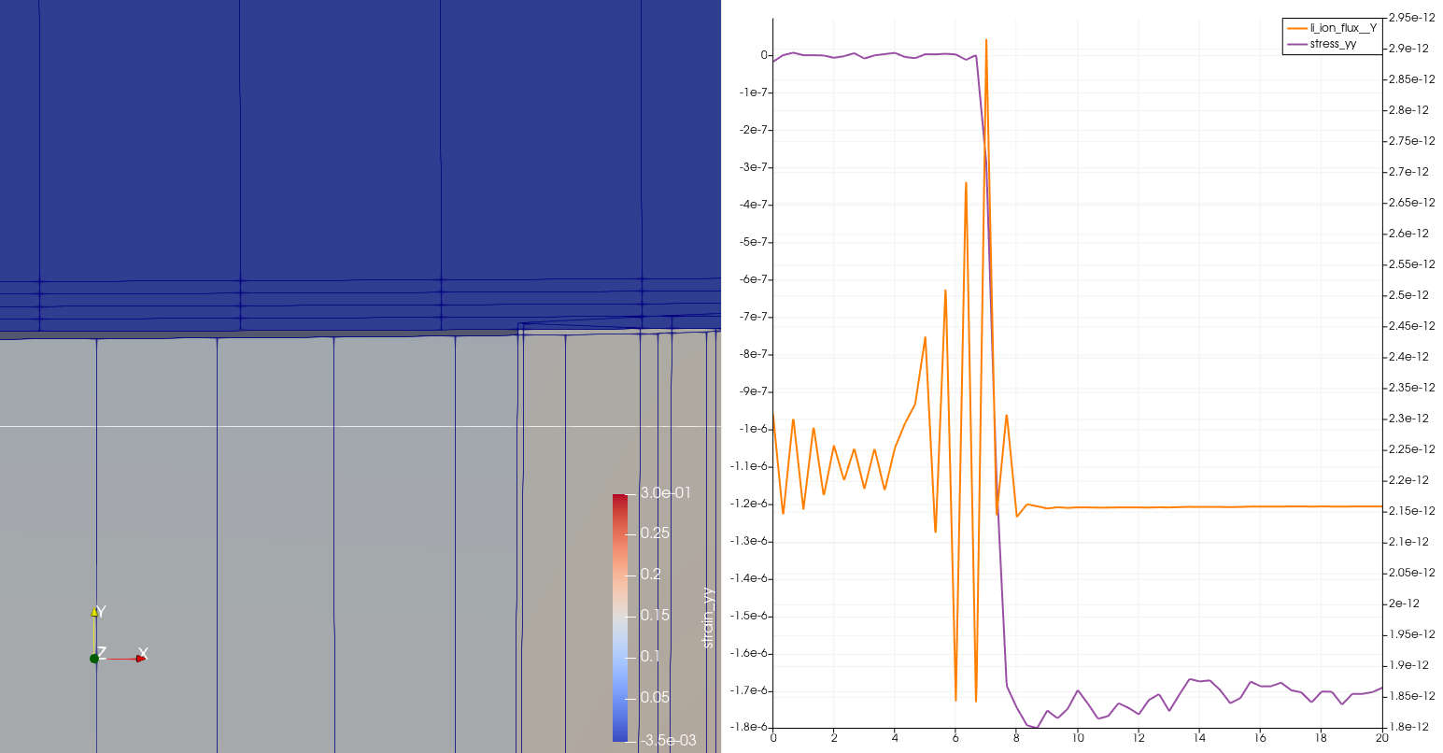
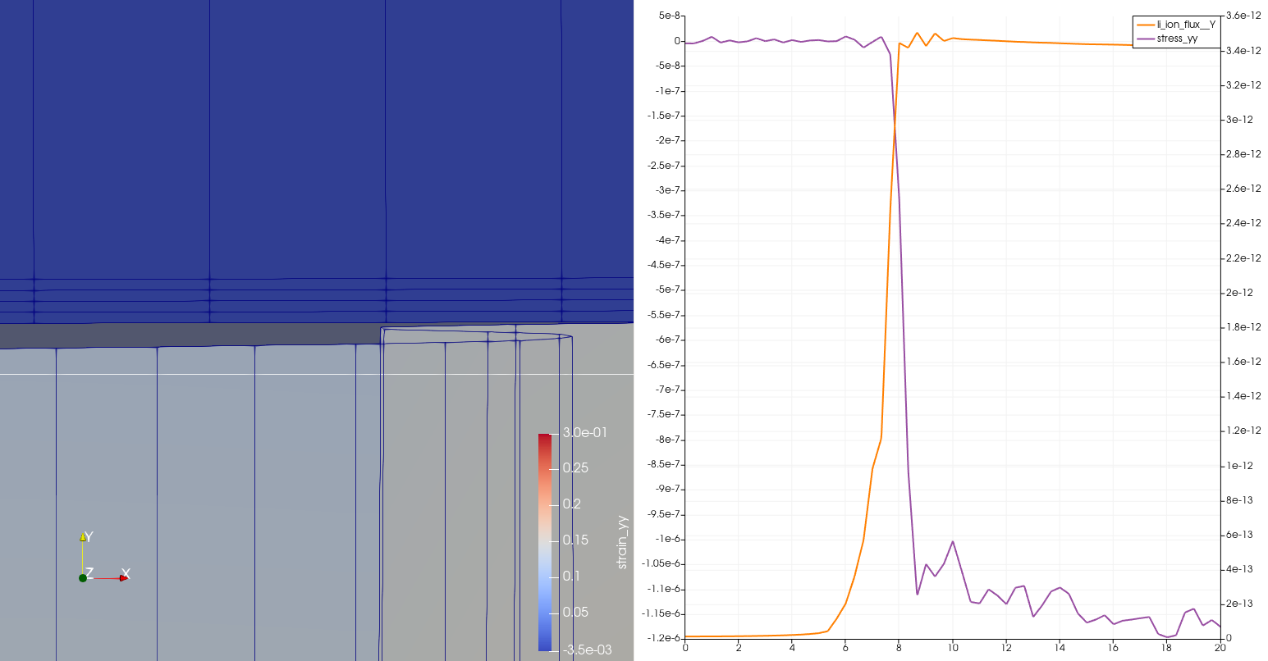
Latest results Stripping
Stripping Results
Current = 0.4 mA/cm^2, Time = 215
Current = 0.4 mA/cm^2, Time = 240
Current = 0.4 mA/cm^2, Time = 340
Simulation are underway as a function of temperature

